Slide 1
Tackling Mental Health Challenges in Nigerian Gen Z
A Data-Driven Approach to Building a Purposeful Mental Health App
Presented by: GROUP ONE

Slide 2
Background & Problem Statement
• Social media pressure is linked to anxiety, loneliness, and low self-esteem.
• Gen Z faces stigma and limited access to affordable therapy.
• Survey conducted to understand pain points and app feature preferences.

Slide 3
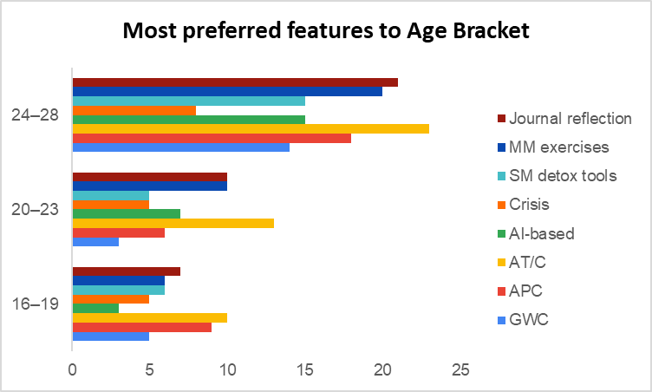
Key Survey Demographics
Age brackets: Majority respondents fall between 16–25.
Ages 24–28 prioritize Journal Reflection, AI tools, and Community features.
Ages 16–19 favor Anonymity and Crisis Support.
Design should reflect multi-feature access based on age preferences.
Preferred features: AI mood tracking, anonymous support, peer forums

Slide 4
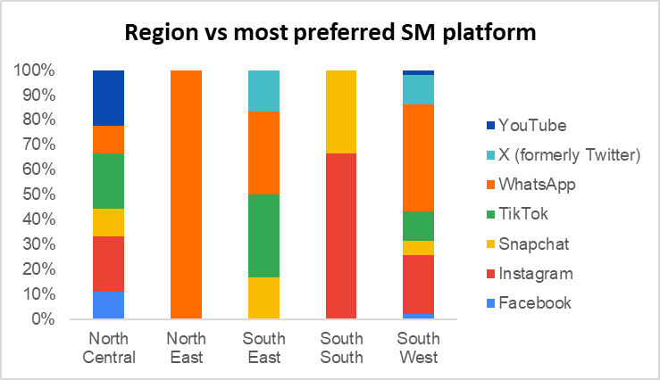
Major Findings from Data Analysis
WhatsApp is the dominant platform across regions, with Instagram and TikTok also ranking high.
Regional variations suggest need for localized platform engagement strategies.

Slide 5
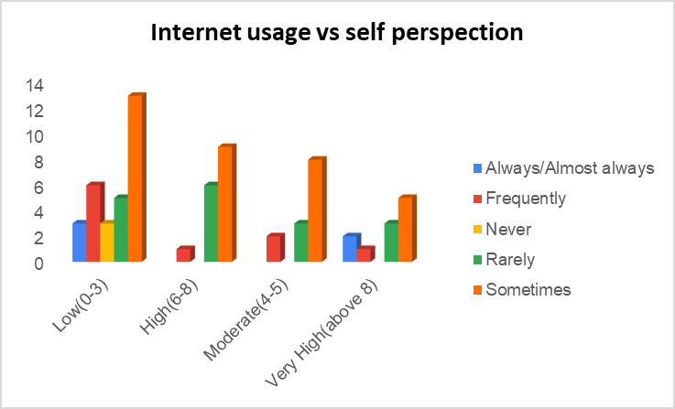
Strategic Insights
Gen Z is digitally native but emotionally vulnerable online.
High daily internet usage: >70% spend 6+ hrs online.
Interest in AI support is growing, but human therapists remain key.
Content moderation is needed but often absent.
Gen Z with higher internet usage tend to report more negative changes in self-perception.
Most 'High' and 'Very High' internet users report 'Sometimes' or 'Frequently' experiencing negative feelings.

Slide 6
Recommended Product Strategy
1. Mobile-first platform with offline access.
2. Affordable, stigma-free teletherapy via certified pros.
3. AI-powered mood tracking and wellness prompts.
4. Social media detox tools: content filtering, screen-time alerts.
5. Peer support through community forums.

Slide 7
Implementation Strategy
• Phase 1: Prototype & test with Gen Z focus groups.
• Phase 2: Rollout in tertiary institutions and NYSC camps.
• Phase 3: Expand nationwide with NGOs & health ministry partnerships.

Slide 8
Call to Action
“To care for the mind of a generation, we must speak their language — digital, empathetic, and accessible.”
We recommended a mobile-first mental health platform that:
- Offers anonymous peer support
- Connects users with verified mental health professionals
- Incorporates gamified self-care activities and progress tracking
- Educates users through culturally relevant mental health content
Let’s build a safe, affordable, and smart mental health space for Nigerian youth.

Slide 9
Thank You / Q&A
• Thank you for your time.
• Questions & feedback welcome.
Team Members:
Bukunmi Adeeko
Tosin Omoleye
Favour C. Nnadozie
Kazeem Bintu Adunni
Ubasom Josemaria

